Slide 1





Slide 2
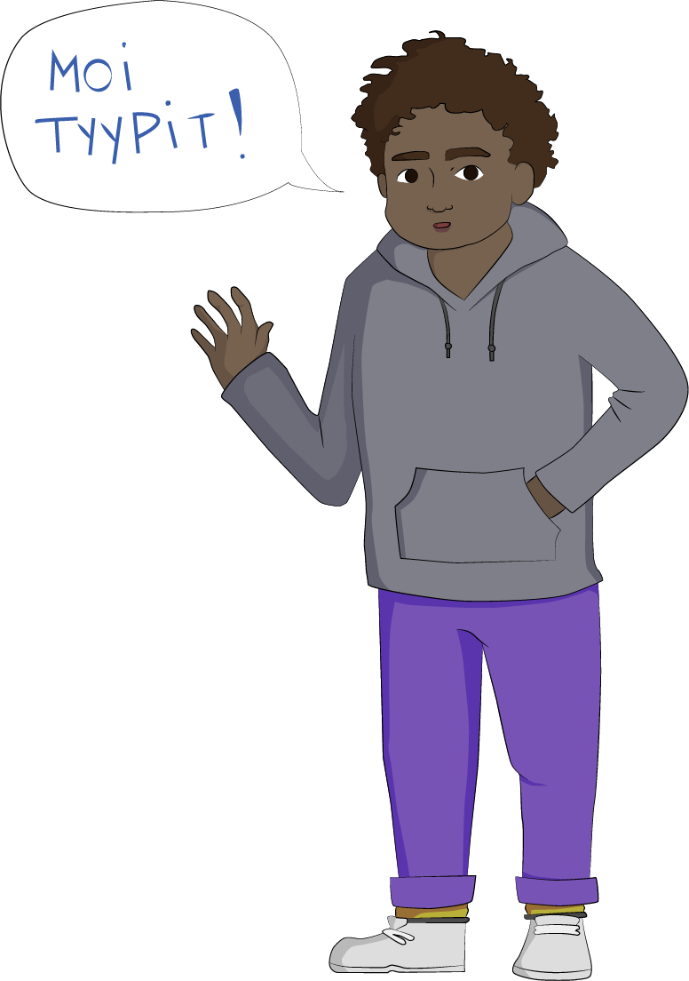
Welcome to the
Together Without Racism training!
This lesson examines factors relating to friendship and social skills. It also deals with how we can tackle racism.

Slide 3
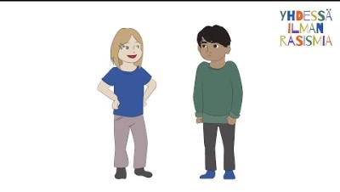
https://youtu.be/ThZYhmktLqY
Microaggressions

Slide 4
Groups and roles
- Everyone is a unique and original individual
- Everyone has different roles in different groups.
- Everyone is an important part of a group and brings different knowledge and skills to the group.
- Everyone can have different roles depending on the group. For example, being with your family might be different from being with your friends.
Task: Take a step forward into the circle if the following statements read out by your teacher describe you or your thoughts.

Slide 5
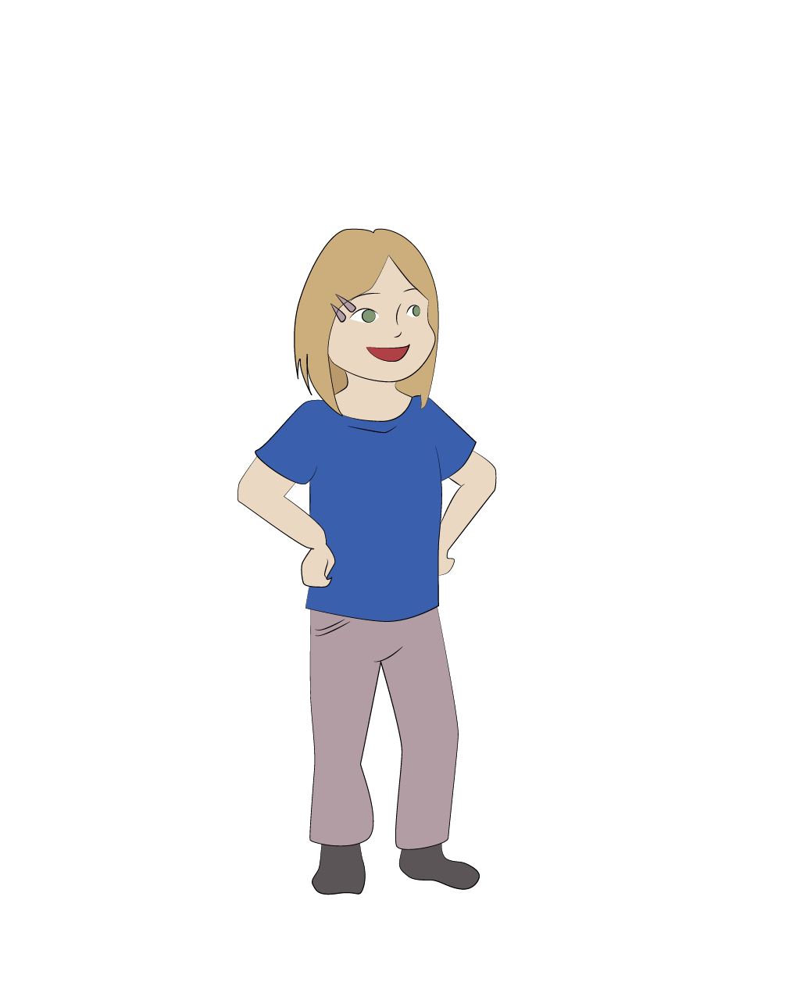
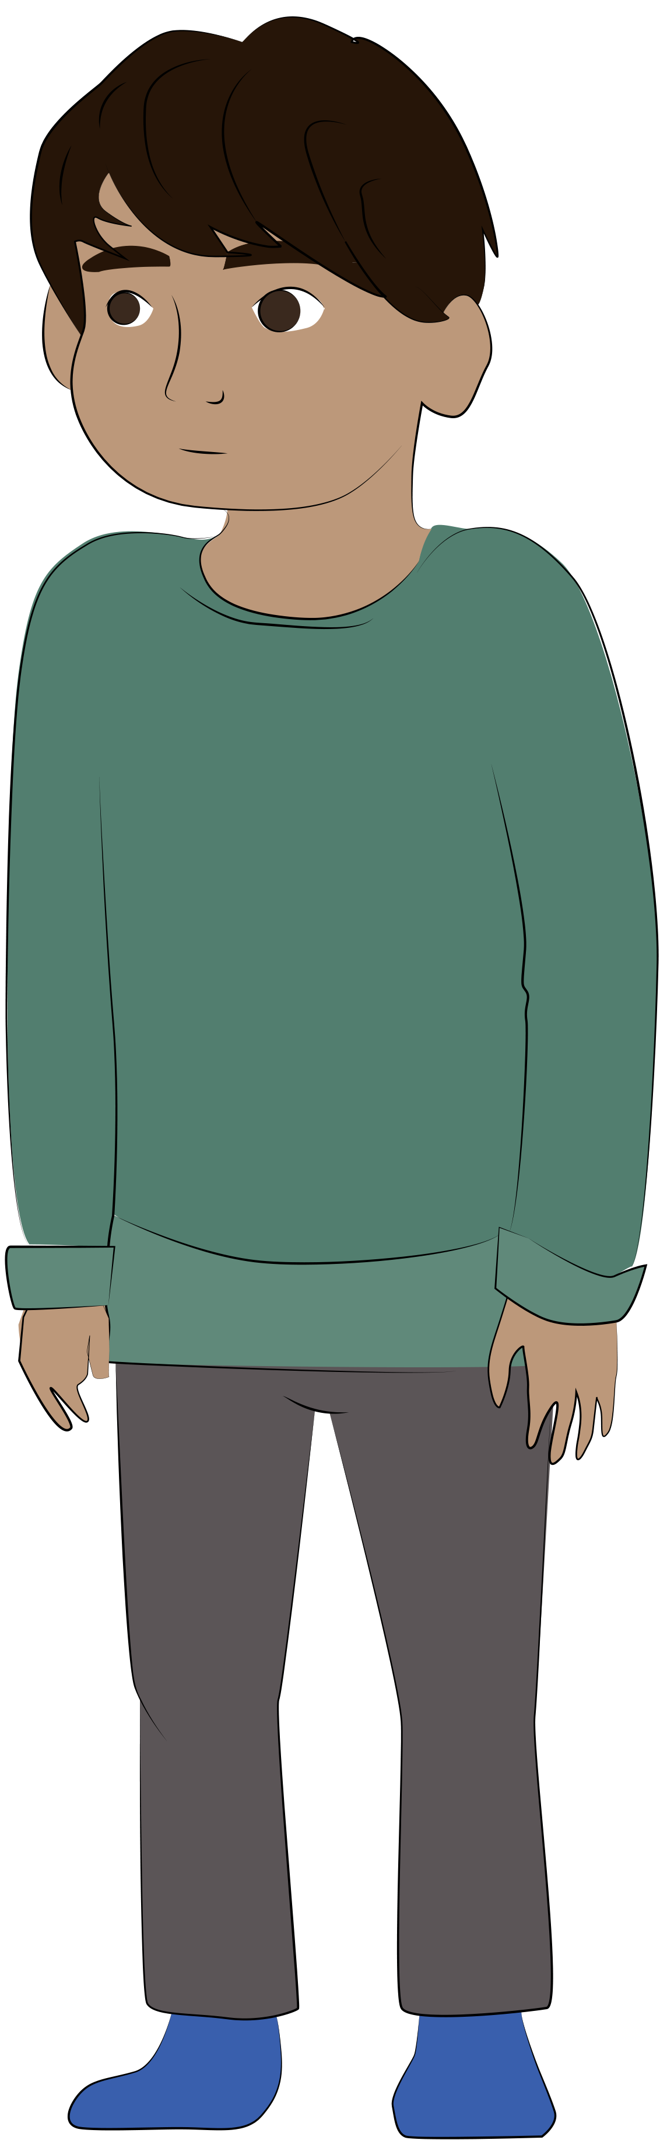
Friendship game
- Play the friendship game, following the instructions given by your teacher.
- Then think about aspects of friendship together.

Slide 6
Different friends and circles of friends can give you new perspectives for your own life. Diversity in friendships can be enriching and a resource!

Slide 7
Do you listen and make eye contact?
Think about something you are ready to share with others.
It could be anything, like:
one positive or happy event from the past week
a nice party you went to
or you can explain something nice about your family or hobby.
Don’t think too hard, sharing how you found a lost key is enough for this exercise!

Slide 8
Task progression:
Each person in each group will take turns to tell their story for around one minute.
The other two members of the group will be given different ways to act and to listen:
Person A. Calmly tells their story to the others.
Person B. Does not actively listen to the storyteller. Does not make eye contact with the storyteller or indicate that they have listened or understood the story.
Person C. Actively listens to the storyteller. Makes eye contact and indicates through gestures, such as nodding, that they are actively listening.
Swap roles until everyone has been in every role.

Slide 9
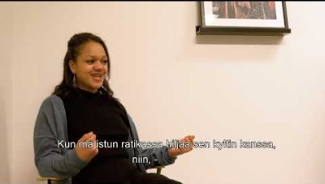
”Hymyillään, välitetään yhdessä” (Let’s smile, and care together)
https://www.youtube.com/watch?v=VFHJTTTsKJg

Slide 10
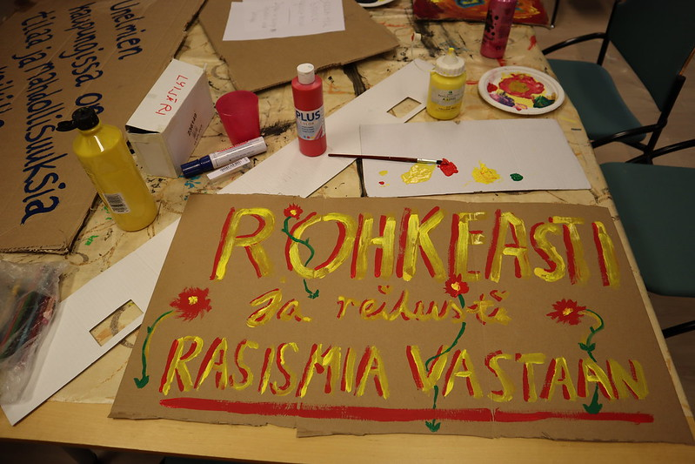
Opportunities to make a difference
Task progression:
- The teacher will present some different statements.
- Give a thumbs up, down, or to the side
to show how much you agree with the statement.

Slide 11

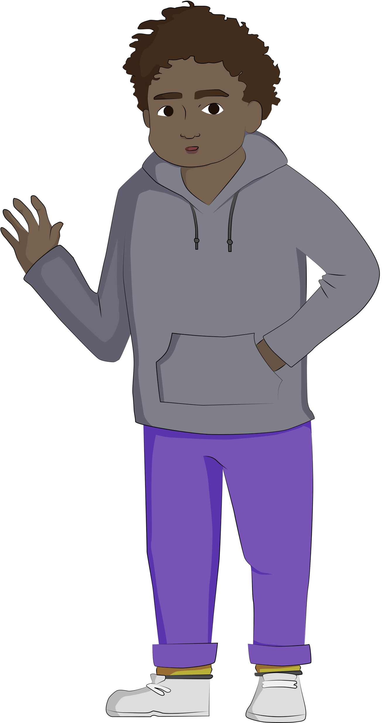
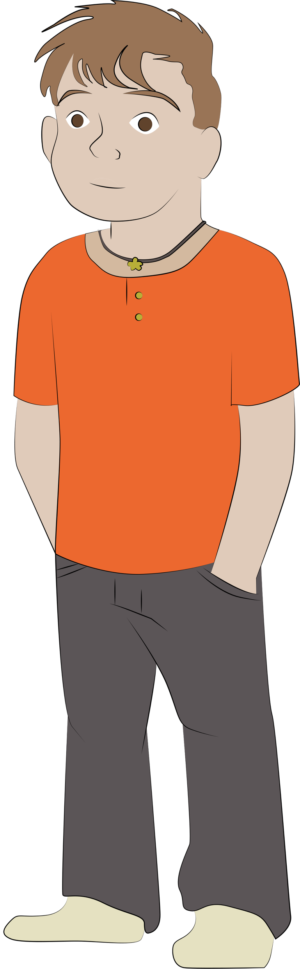
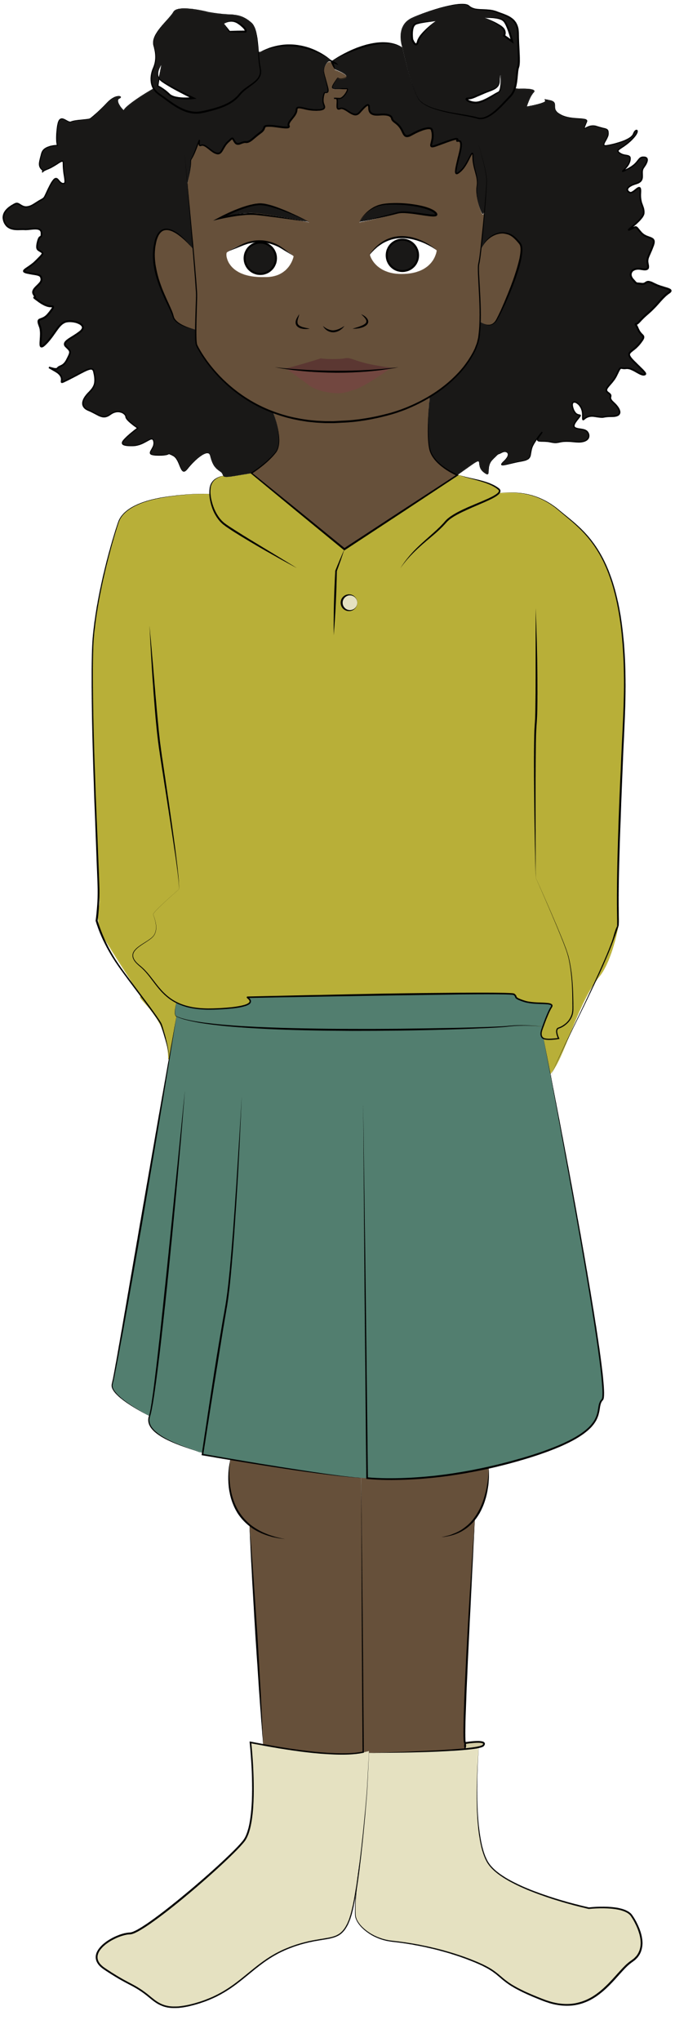
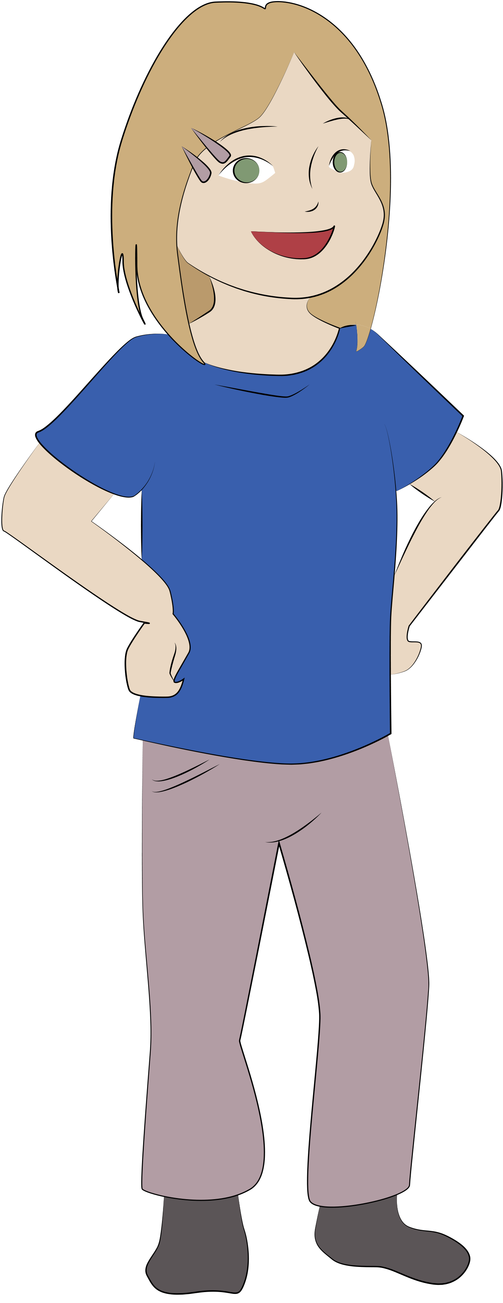
Let’s make our living environment fairer and an equal place for everyone to live and be.
Everyone can make a difference!

