Slide 2
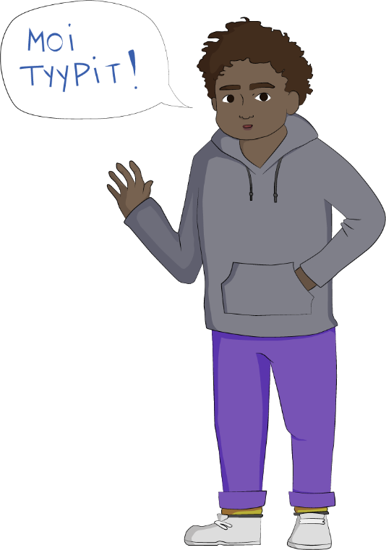
Welcome to the Together Without Racism training!
This lesson will examine racism concepts and think about how human and cultural diversity is visible in our environment.

Slide 3
Notes:
So how does racism come about?
Racialization That’s when we think that we can know something about a person based on how they look. Assumptions

Slide 4
Let’s watch the music video ”Takas mestoil” NaharY "Takas mestoil" feat. Diison
In pairs or groups, discuss the music video.
What do you think the video is about?
What do you feel when you watch the video?
How does the music video relate to what we have previously talked about?

Slide 5
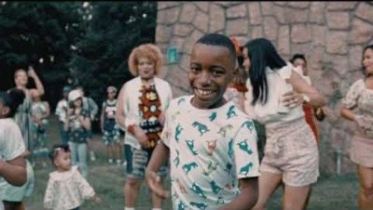
NaharY "Takas mestoil" feat. Diison

Slide 6
In pairs/groups, look at different learning materials or images in the media using the following supporting questions:
Do books show any people that look different from each other? For example, What skin colours can you find?
What do the people who are smiling or who seem happy look like?
What do the people who are sad look like?
What do the people in positions of power look like?
What do the people who have no privilege look like?
What do the main characters look like?
Can you find any different languages in the pictures?
Can you see any different religions in the pictures? Are they in Finland, or only shown outside of Finland?
What festivals can you find, and which can’t you find?
Can you find anyone in the images that you relate to?
What do the people who are depicted as Finns look like?
What kind of things and and people are depicted as Finns?
What kind of things and and people are depicted as foreign?
Do you think anything should be changed in the images? What?

